Slide 1
INTERNSHIP
MID PRESENTATION
Presented by
Md Masum Billah
1

Slide 2


About the Company
B-Trac Solutions Ltd. is a prominent ICT (Information & Communications Technology) company based in Dhaka, Bangladesh. It specializes in digital services, IoT solutions, and software development for web, mobile, desktop, and embedded systems.
They operate under the Bangla Trac Group.
https://www.btracsolutions.com
2

Slide 3
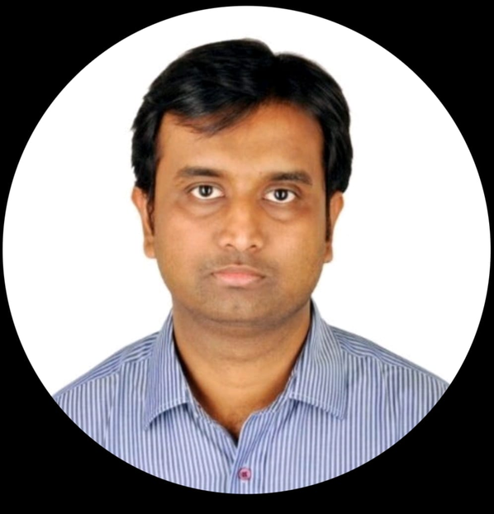
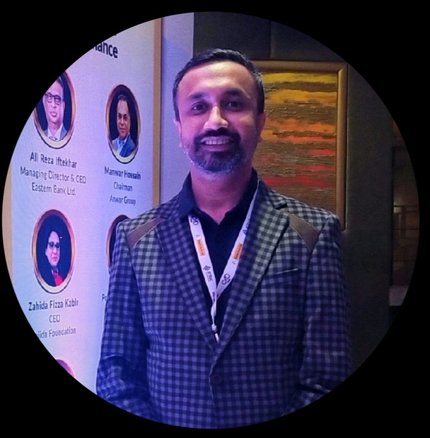
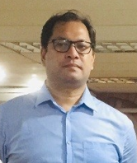
Company Hierarchy
Mohammed Tanvir Siddique
CEO
Safayet Abdullah
Head Of Projects
Ashok Sinha
Senior Project Manager
3

Slide 4





Yes Parking
Nirapath
Carcopolo
Company Products
A smart urban parking solution
A personal safety app
A complete vehicle-tracking service
SEEMO
Workopolo
A smart home security solution
Streamlined workplace communication
4

Slide 5



Company Projects
Banani Club Limited
Doorstep Delivery
DMP Duty
A family-oriented recreational and sports club
An all-in-one solution for restaurants to coordinate, track
Tracking on-duty staff, mainly within the DMP traffic division
5

Slide 6
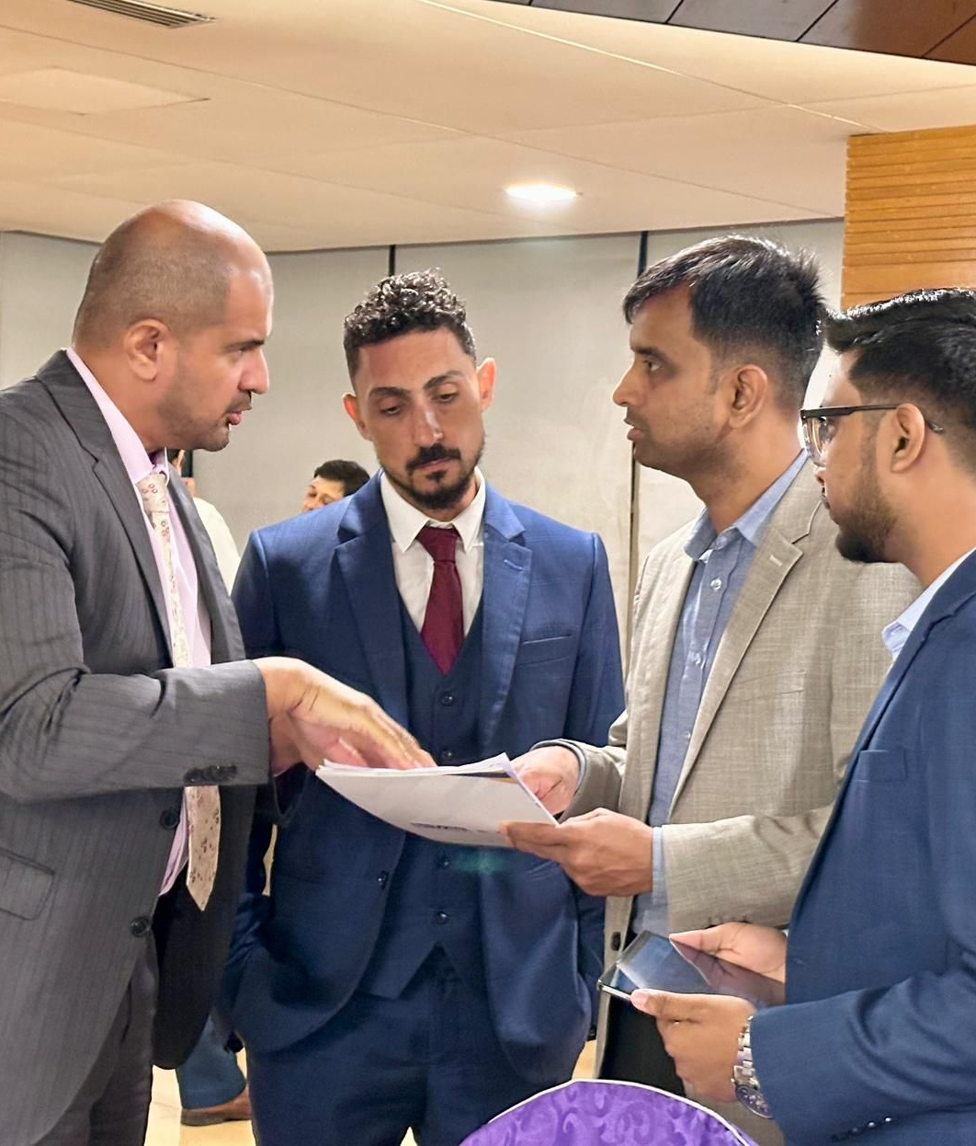
Work Culture
Office hours
9:00 AM – 6:00 PM.
Matches typical corporate hours.
Employee verification
The company verifies employees but this verification process does not apply to interns.
Lunch
The company provides lunch for everyone, which helps maintain convenience during working hours.
6

Slide 7
Joining
I joined as an Software Engineer intern in the development team on 07/09/25.
7

Slide 8
1. Upon joining, we went to the HR office to fill out the required forms.
2. After completing the paperwork, we were introduced to the another ofice, where the development team works.
3. The development lead introduced us to the rest of the team.
4. Because of limited seating, all interns were seated together in a meeting room.
Onboarding Experience
8

Slide 9
1. Finding accommodation
2. Transportation: The roads were too polluted.
3. Fitting into company culture: Understanding the norms, working style, and expectations.
4. Proving your skills: Interns are sometimes assumed to only have basic skills, so I had to demonstrate more advanced skills.
Initial Challenges
9

Slide 10
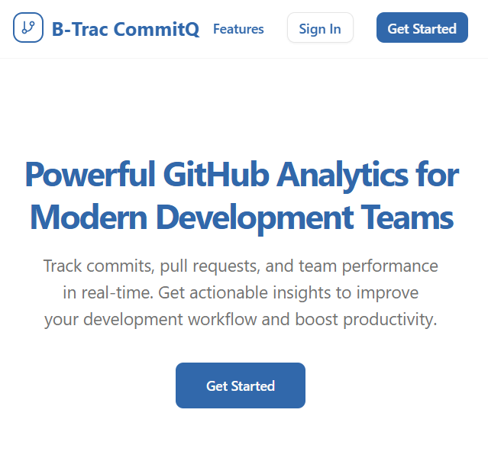
Assigned Project
B-Trac
CommitQ
GitHub analytics system for tracking internal team performance
10

Slide 11
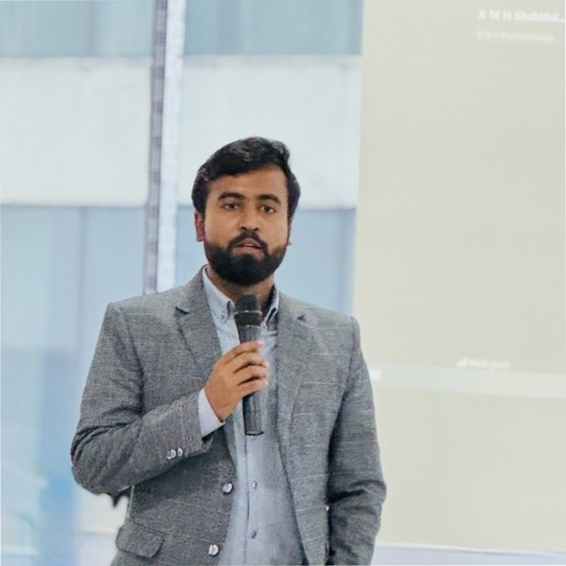
Project Supervisor
Md. Mazba Kamal
Development Lead, Web Applications
B Trac Solutions
mazba.kamal@btracsl.com
11

Slide 12




My Responsibilities
Frontend
Designing and implementing the user interface for CommitQ using modern web technologies.
Backend
Building APIs and server-side logic to fetch and process GitHub analytics data.
Deployment
Successfully deploying the application to a VPS and ensuring it runs smoothly in a production environment.
12

Slide 13

Challanges
While working on CommitQ, I encountered and solved multiple real-world challenges
Type Definitions
GraphQL Query Handling
Deployment
13

Slide 14
New Skills
TypeScript
Improved code quality with strong typing and error prevention.
Next.js
Built fast, scalable, and SEO-friendly web applications.
GitHub GraphQL API
Learned to structure and query data efficiently using GitHub’s GraphQL API.
Deployment
Hands-on experience with server environments, command-line operations, and VPS management.
14

Slide 15

Project Progress
B Trac CommitQ
B-Trac CommitQ is designed to give powerful analytics and activity tracking for any GitHub Organization. It visualizes repo activity, pull requests, issues, and team contributions — all in one dashboard.
CommitQ
http://103.168.140.122/github-dashboard
15

Slide 16

Future Learning Goals
Workopolo
Workopolo is a mobile & web based application that makes easier communication process between manager & employee or supervisor & subordinate.
Our app helps manager or supervisor to keep track tasks of own and their employee or subordinates.
Through our app user can create minutiae schedules which assures our users to make use of their office hours more efficiently.
16

Slide 17
Thank You!
For your listening...
17

